Slide 1
Best Route Calculator
CIS27 Final Project
Jiawei Huang

Slide 2
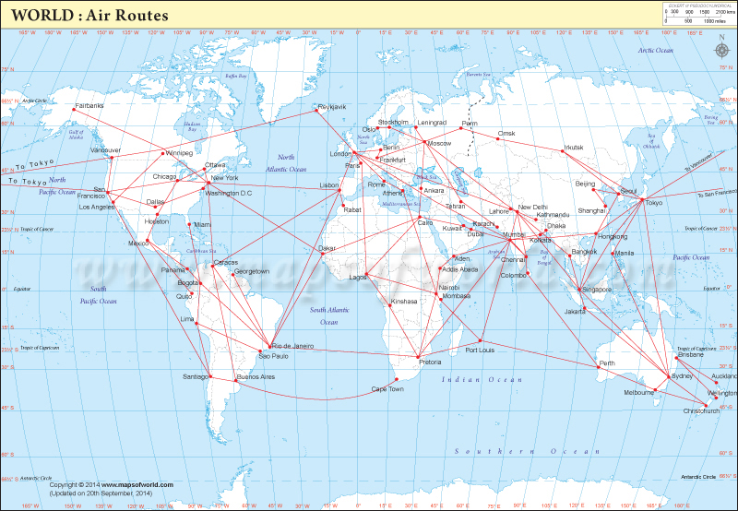
Best Route Calculator is a software to let travelers know the shortest distance or the lowest cost route when they don’t know how to choose the route in a complex route map.

Slide 3
PACKAGE STRUCTURE
View package: contains All GUI class, to show data to user.
Utils package: contains all utils class. Utils class can be used in any project
Service package: Operate the data before storage in database or show to user
Model package: Contains the class corresponding to the database table
Dao package: contains the class about the connections and operation of the database

Slide 4
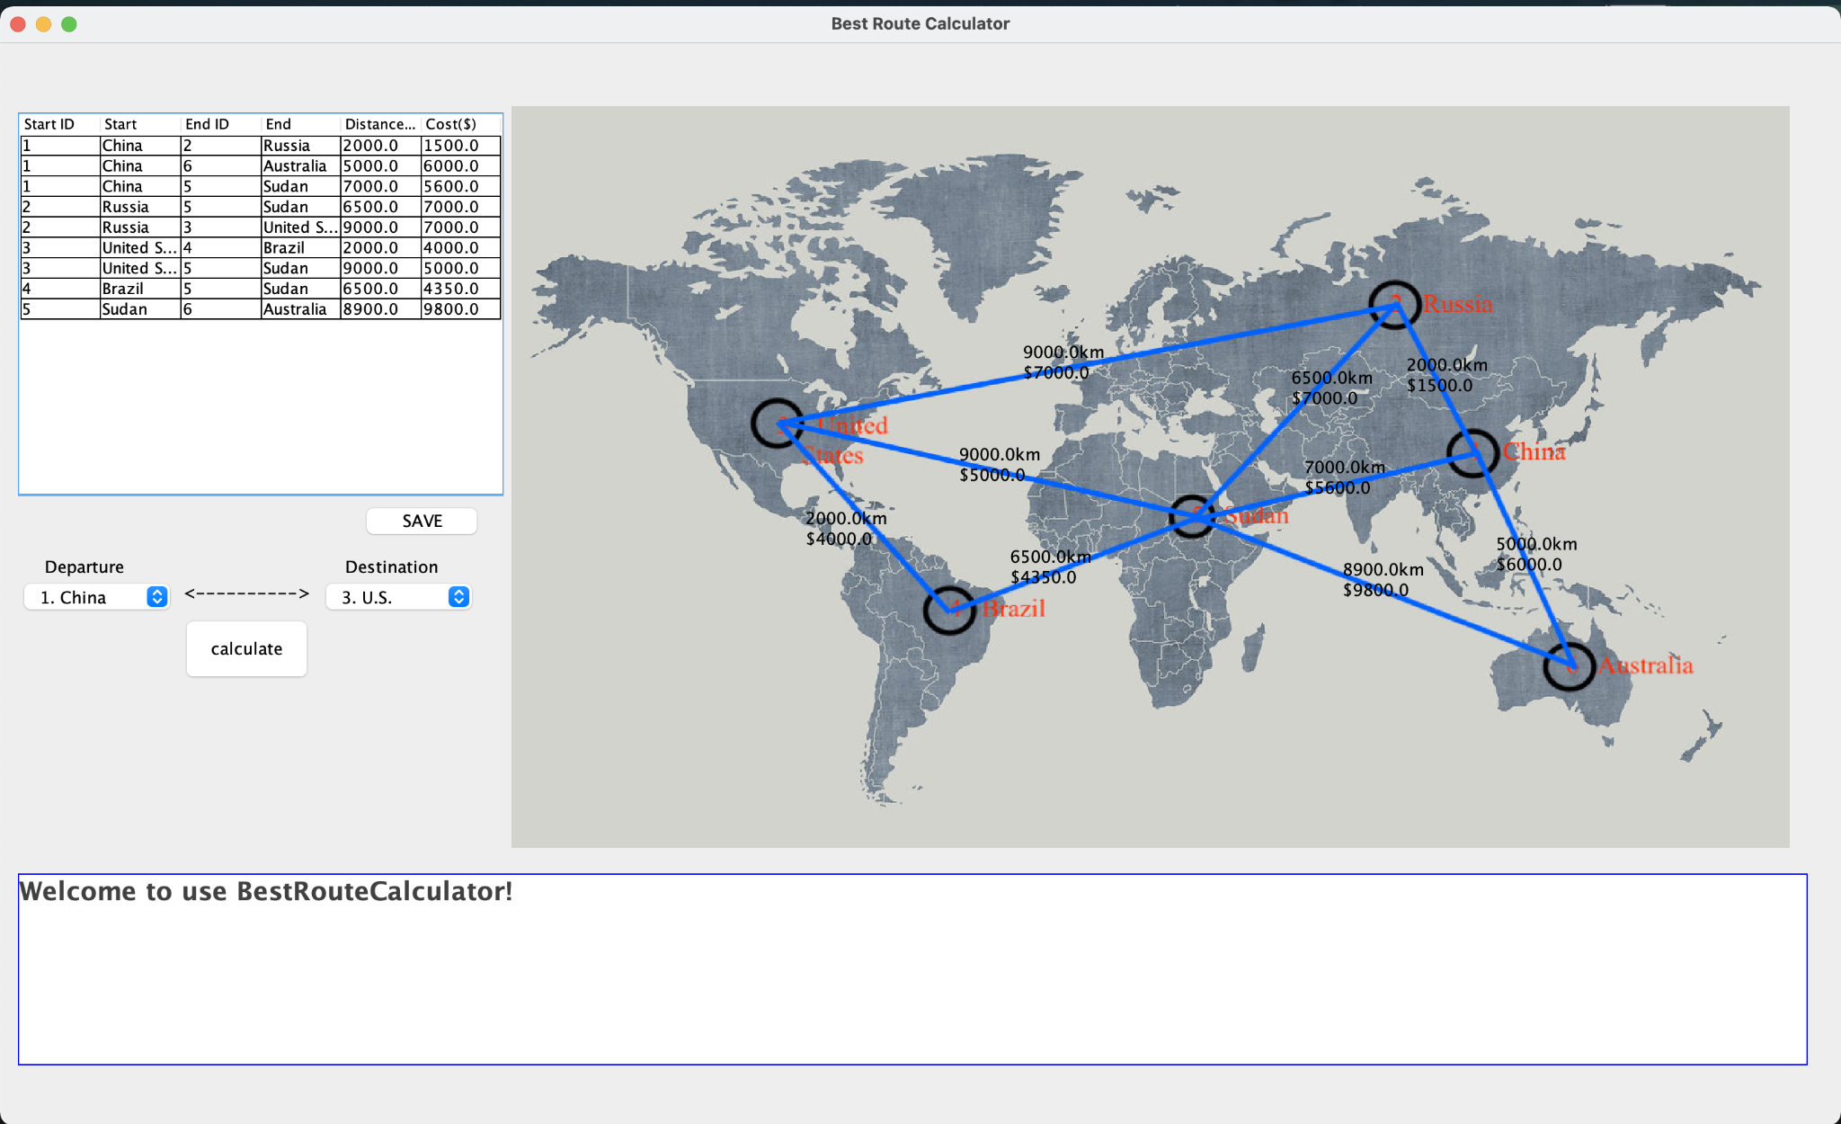
Route Data Table
Places selection and
Calculator Button
Text area Show calculation result

Slide 5
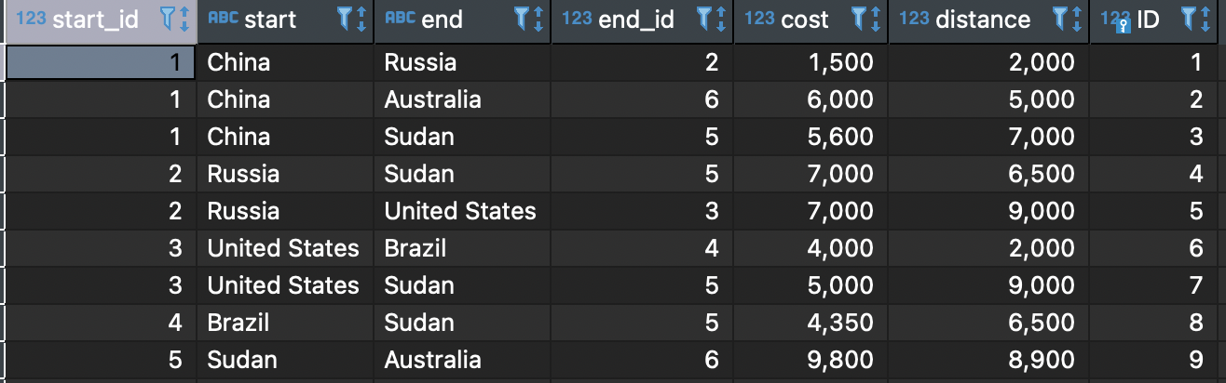
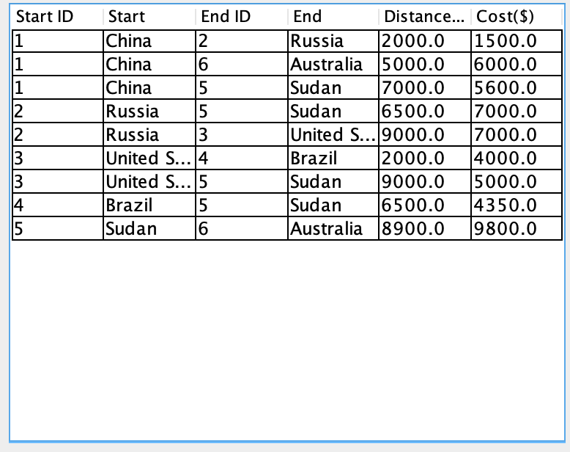
Get data from database
storage the data in two dimensional array
Show the data in JTable

Slide 6
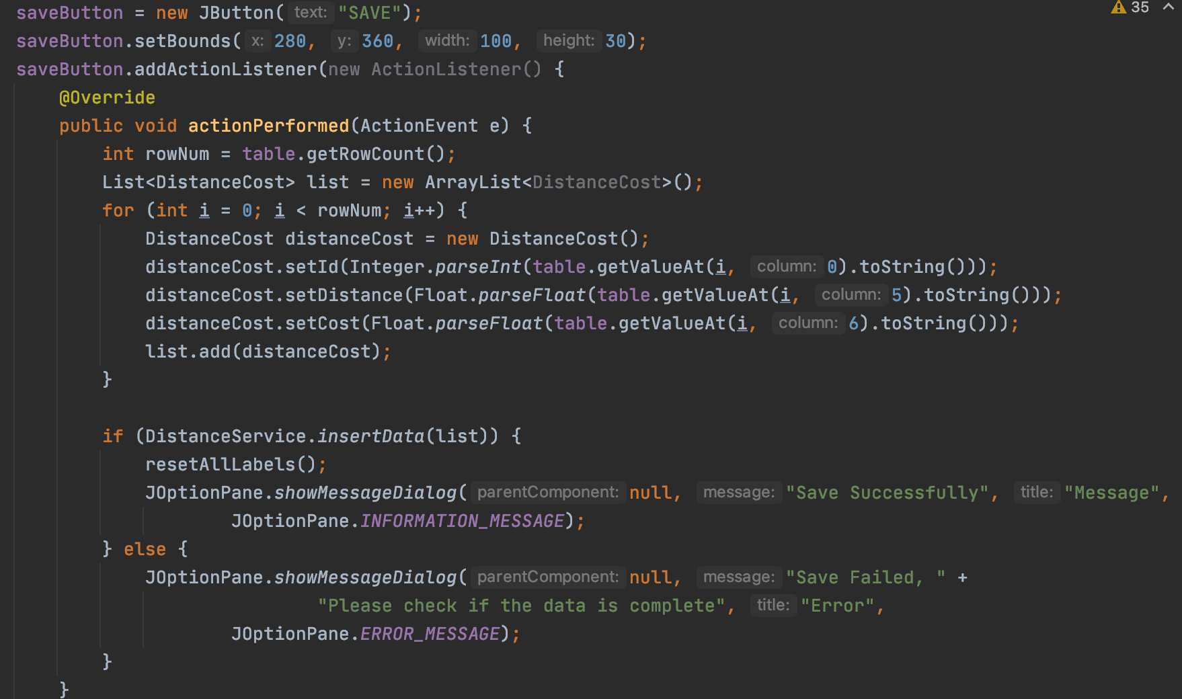
Save Button Implement
Click Button to Run actionPerformed() function
Collect the data from the table
Insert the data to database
If insert successfully, Show OK Dialog and reset the label to black color. If fail, show error dialog

Slide 7
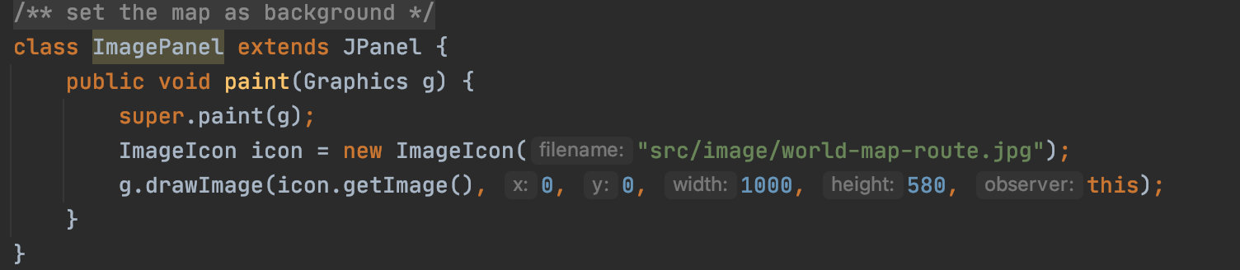
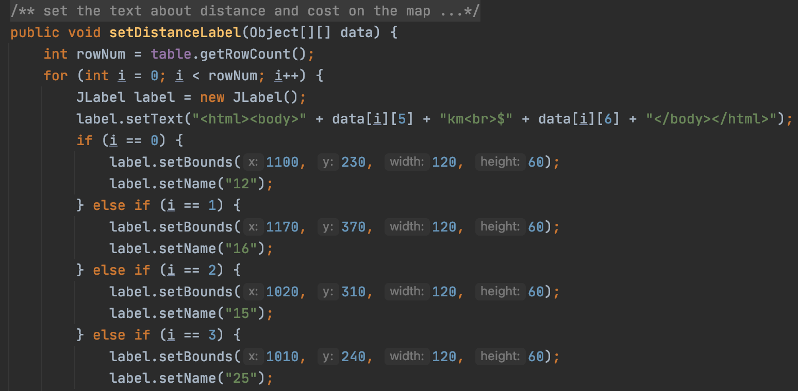
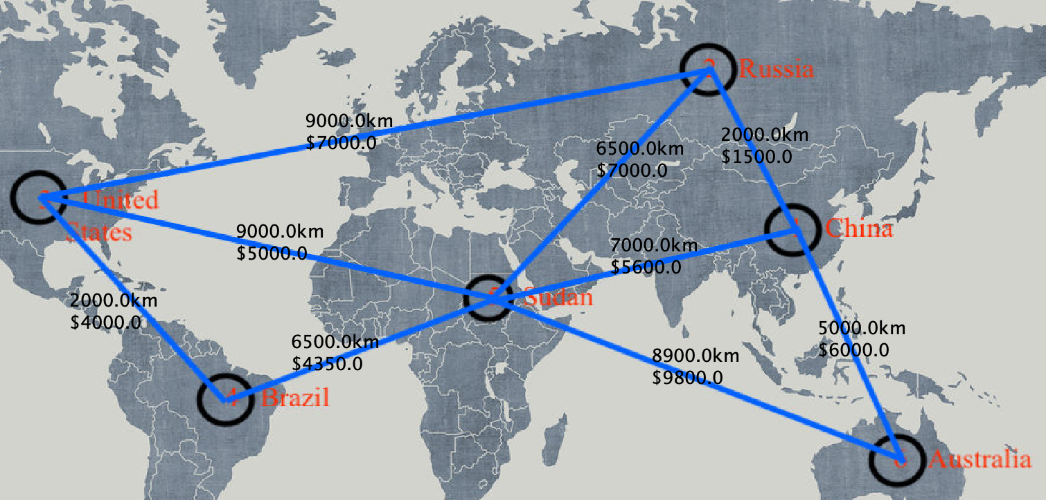
Get Image from resource file and set the Image as background
Using JLabel to add distance and cost number on the picture
Show up the route map

Slide 8
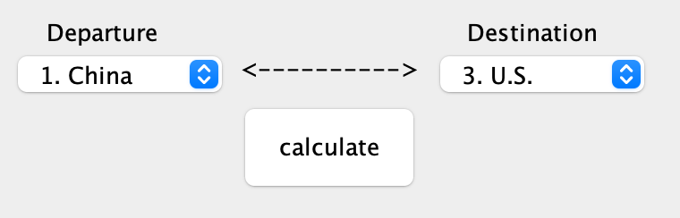
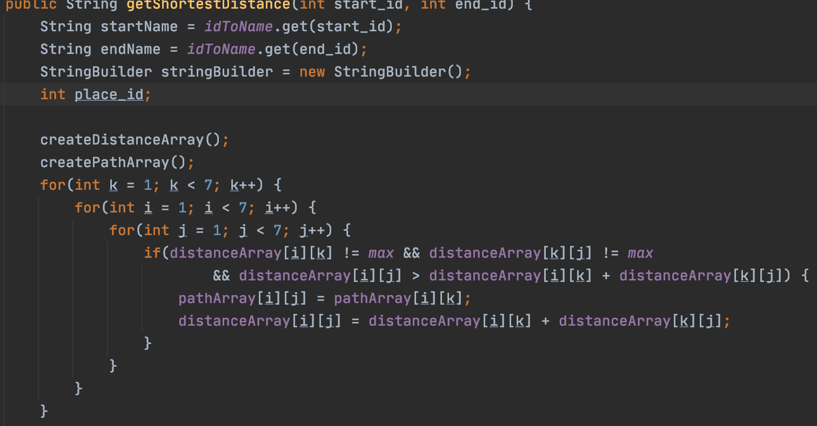
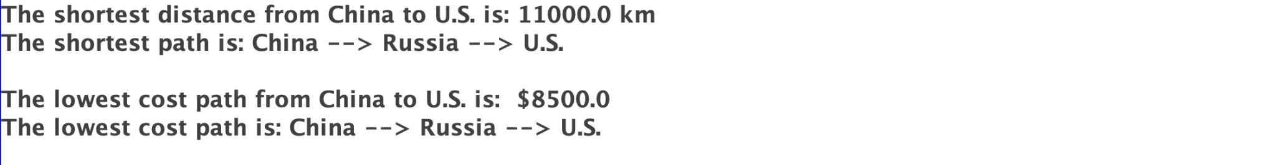
Get start Id and end Id
Send them to calculator function()
Using Floyd Warshall Algorithm to calculate the shortest distance and get shortest path
Show up the result in TextArea and Change the text color on the map

Slide 9
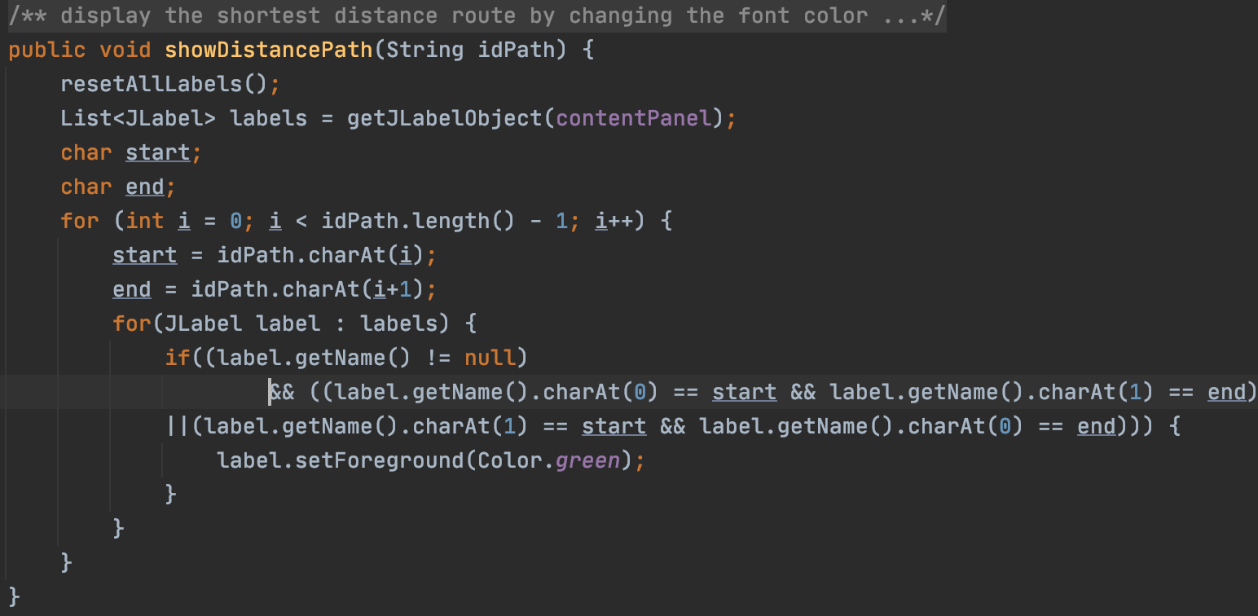
Reset all my labels color to black
idPath string is a collection of passed place ids.
Example: “153” means the path from 1 to 5 to 3.
Change the labels color by idPath
Example: “153” means change the labels color which name is “15” and “53”

Slide 10
Floyd-Warshall Algorithm
Floyd-Warshall Algorithm is an algorithm to find shortest distances between every pair of vertices in a weighted directed graph

Slide 11
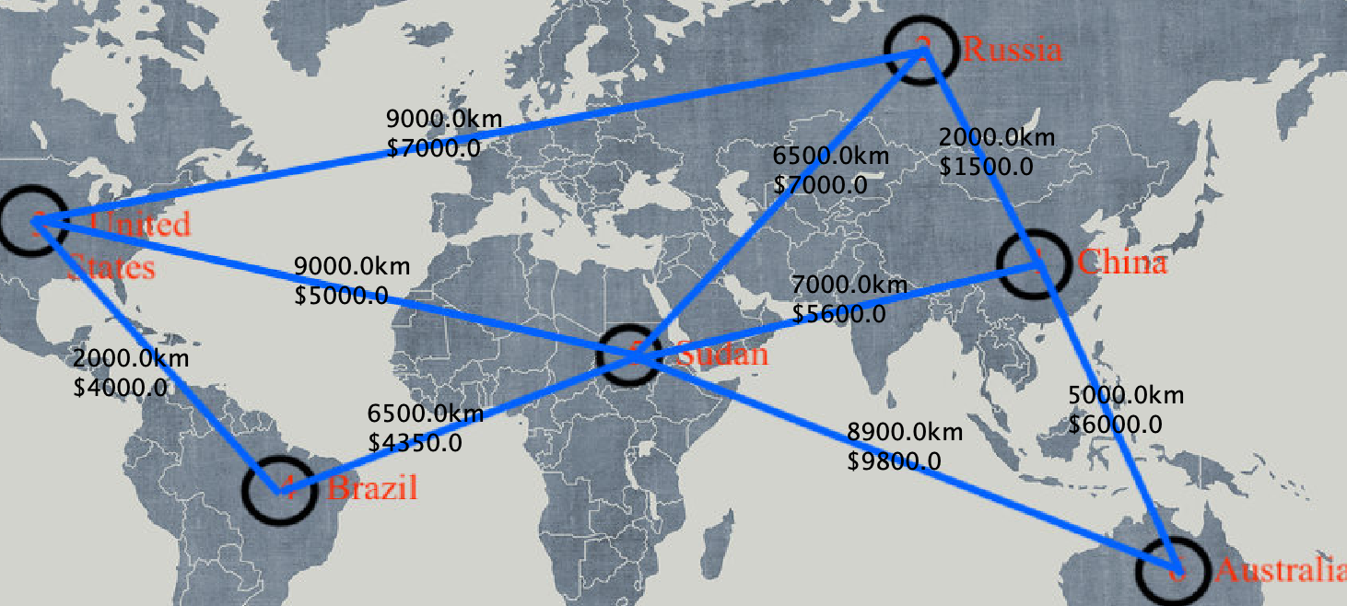
Floyd Warshall Algorithm
 | 1 | 2 | 3 | 4 | 5 | 6
1 | 0 | 2000 | INF | INF | 7000 | 5000
2 | 2000 | 0 | 9000 | INF | 6500 | INF
3 | INF | 9000 | 0 | 2000 | 9000 | INF
4 | INF | INF | 2000 | 0 | 6500 | INF
5 | 7000 | 6500 | 9000 | 6500 | 0 | 8900
6 | 5000 | INF | INF | INF | 8900 | 0
Convert the route map to an adjacency matrix
Adjacency Matrix:
Rows and Columns labeled by graph vertices.
If a pair of vertices are adjacent, record the distance. otherwise record infinity
Example: matrix[1][2] = 2000 means the distance from 1 to 2 is 2000 km

Slide 12
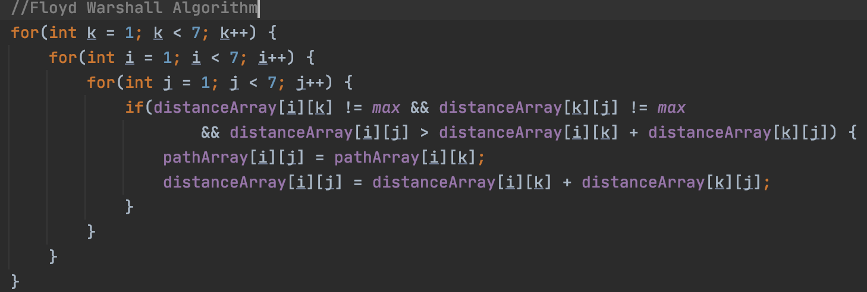
Floyd Warshall Algorithm
Core code
It contains three for-loop → Time Complex O(n^3)
If we find a vertex k such that
distance from i to k + distance from k to j < distance from i to j
, that’s mean i -> k -> j is a shorter distance path.

Slide 13
Floyd Warshall Algorithm
 | 1 | 2 | 3 | 4 | 5 | 6
1 | 0 | 2000 | 11000 | 13000 | 7000 | 5000
2 | 2000 | 0 | 9000 | 11000 | 6500 | 7000
3 | 11000 | 9000 | 0 | 2000 | 8500 | 16000
4 | 13000 | 11000 | 2000 | 0 | 6500 | 15400
5 | 7000 | 6500 | 8500 | 6500 | 0 | 8900
6 | 5000 | 7000 | 16000 | INF | 8900 | 0
 | 1 | 2 | 3 | 4 | 5 | 6
1 | 0 | 2000 | INF | INF | 7000 | 5000
2 | 2000 | 0 | 9000 | INF | 6500 | INF
3 | INF | 9000 | 0 | 2000 | 9000 | INF
4 | INF | INF | 2000 | 0 | 6500 | INF
5 | 7000 | 6500 | 9000 | 6500 | 0 | 8900
6 | 5000 | INF | INF | INF | 8900 | 0
After running the algorithm
Shortest Distance Matrix
It contains shortest distance between any pair of vertices
Example:
Shortest distance from 2 to 6 is matrix[2][6] = 7000 km
Shortest distance from 5 to 6 is matrix[5][6] = 8900 km

Slide 14
Future Implement
Function to add and delete places
Let user can select place on the map
Get data from a service

Slide 15
Thank you!

